Slide 1
Word Bigrams and Nonlinear Scaling of Word Saliences for Sentiment Modeling in Online Product Reviews
Andrew Olson, Isha Paudel, Hynek Boril
Pioneer Speech Signal Processing Lab (PSSPL)
Electrical and Computer Engineering Department, University of Wisconsin–Platteville
27th IEEE/ACIS International Summer Conference on Software Engineering, Artificial Intelligence, Networking and Parallel/Distributed Computing (SNPD2024-Summer)
Communication University of China in Beijing, July 5 to 7, 2024

Slide 2
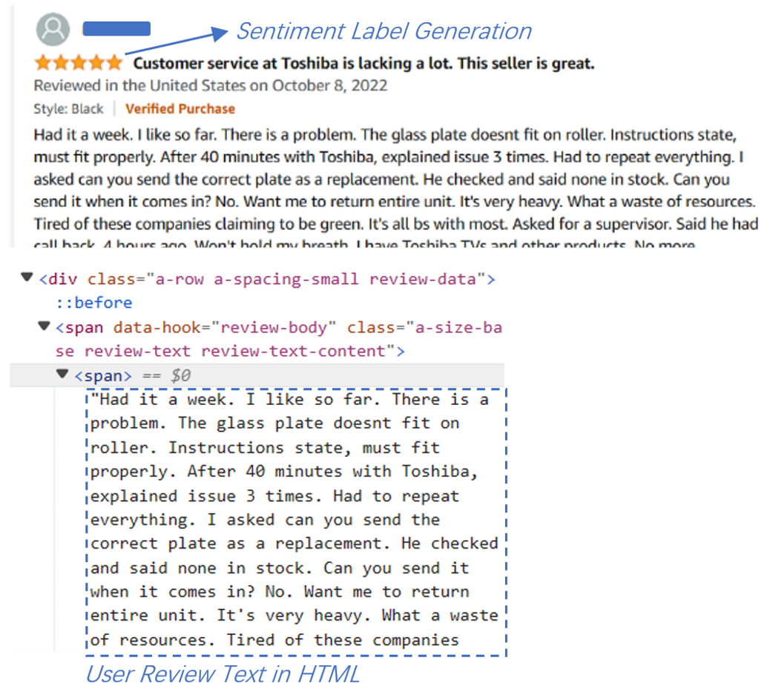
Objectives
Sentiment analysis studies often rely on publicly available resources
Goal: Establish a complete sentiment analysis for user product reviews from scratch
Web scraping
Building Dictionary
Analyzing sentiment-specific unigram/bigram frequencies
Extracting Bag-of-Words review representations
Leveraging inter-sentiment differences in unigram/bigram frequencies → boosting BoW dimensions based on frequency differences
Studying impact of exponential scaling on the weighting matrix
Lexical analysis of prominent entries within sentiment classes and entries with high discriminability

Slide 3
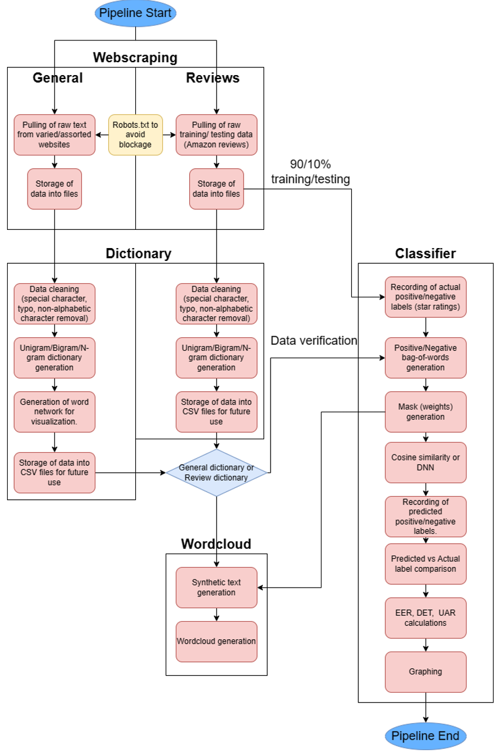
Processing Pipeline
Data Acquisition
Web scraping
Building Dictionaries
A general English dictionary extracted from lightly curated text websites (absence of emoji and expected low frequency of nonstandard words and typos)
A review dictionary extracted from training portion of the collected Amazon reviews dataset
Raw (all text accepted)
Curated (character strings not found in the general English dictionary filtered out)
Classifiers
Front-End: BoW review representations
Cosine Similarity back-end classifier
Fully-Connected DNN classifier

Slide 4
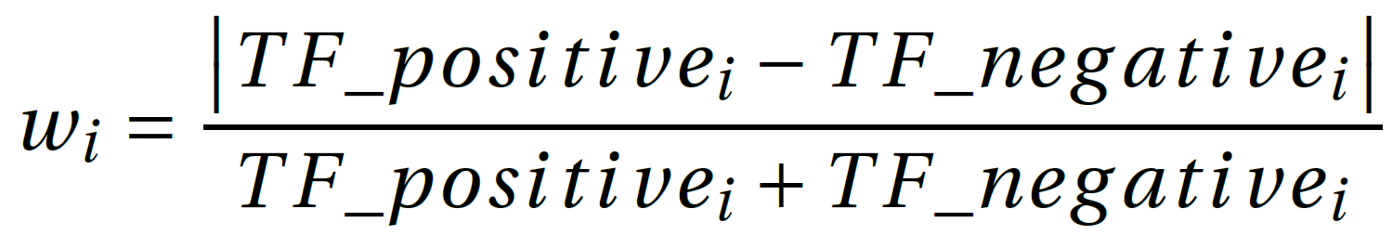
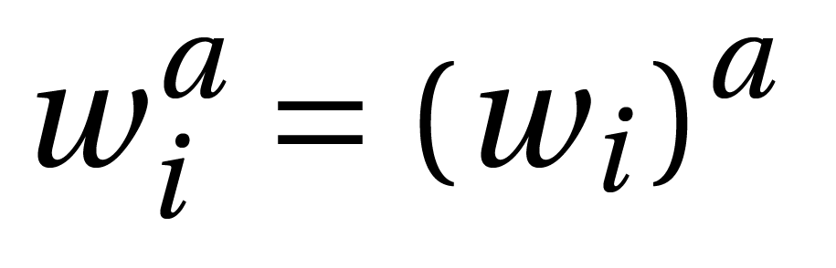
Polarity-Salient Weighting Mask
Term frequency (TF) – frequency of occurrence of the term (unigram or bigram) across all training reviews within the given polarity
Polarity-Salient Weighting Mask (w_{i}) – relative TF differences between the positive and negative classes for the given entry are used to boost weights; concept – terms that appear frequently in one class and rarely in the other may carry more discriminative power and benefit from boosting
Exponential Scaling of Weighting Mask – inspired by success of squashing functions applied on super vector dimensions in Phone Recognition-Support Vector Machine (PR-SVM) systems; expo weighting can be used to either compress or expand the Weighting Mask dynamics and potentially aid the back-end classifier model

Slide 5
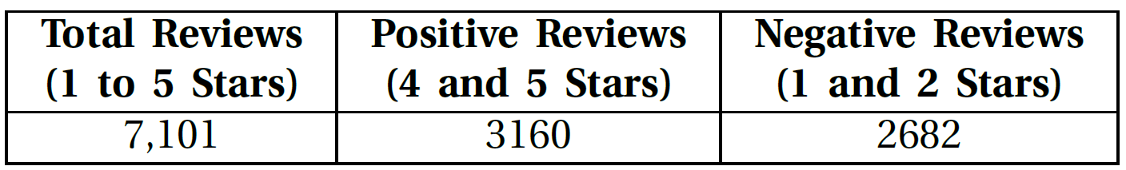
Experimental Dataset
Collected ~7K Amazon’s microwave oven user reviews (1-5 stars)
Used 1–2 star reviews to represent negative sentiment and 4–5 star reviews for positive sentiment
Discarded 3-star reviews; ambiguous sentiment

Slide 6
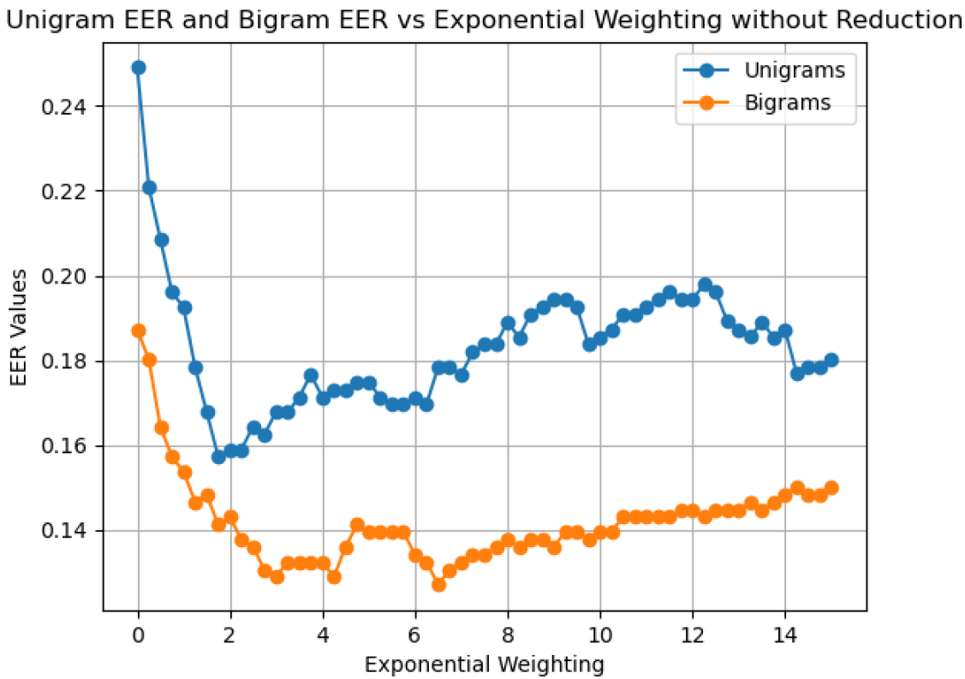
Impact of Exponential Scaling of Weighting Mask
Expo weighting by tunable parameter a
a = 0 → weighting mask is turned off as all entries are uniform ( = 1)
0 < a < 1 → weighting mask entries are compressed
1 < a → weighting mask entries are expanded

Slide 7
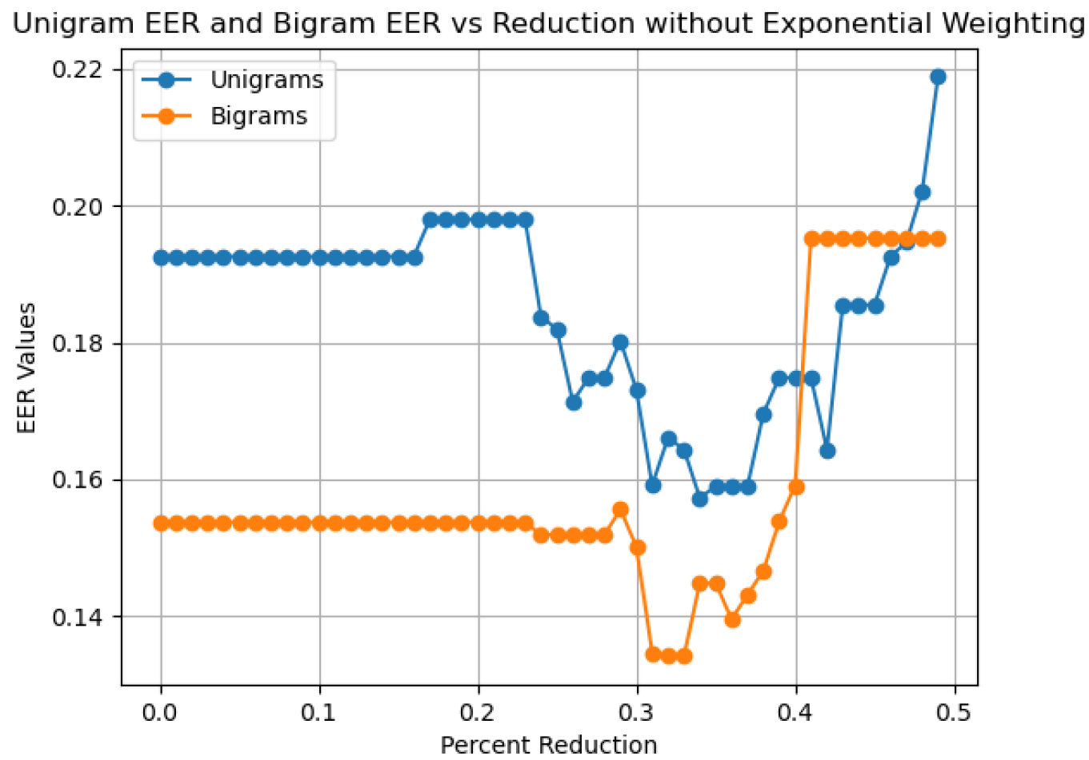
BoW Dimension Reduction
Experiments with removal of BoW dimensions with lowest weighting mask values
Concept – removal of these dimensions will lead to smaller BoWs and hopefully smaller and more robust back-end models

Slide 8
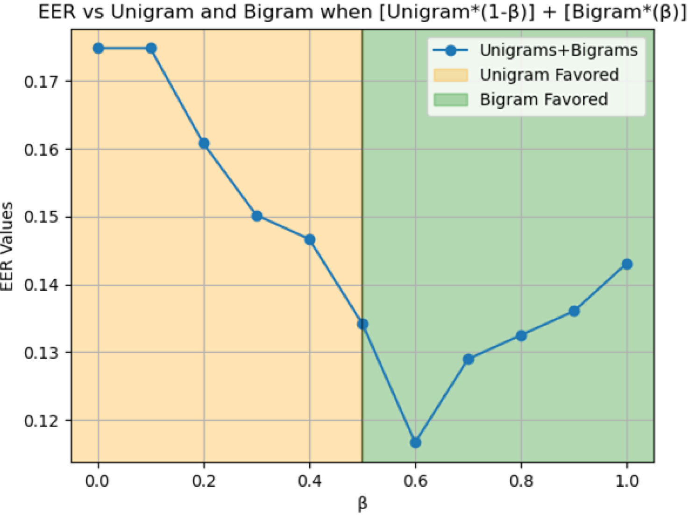
Fusion of Unigram & Bigram BoWs
Concept: Unigram and bigram representations make contribute complementary information toward classification
Implementation – scaling and concatenation of unigram and bigram BoWs; this concept is only applied in the context of the cosine classifier
[(1 - β) Uni, β Bigrams]

Slide 9
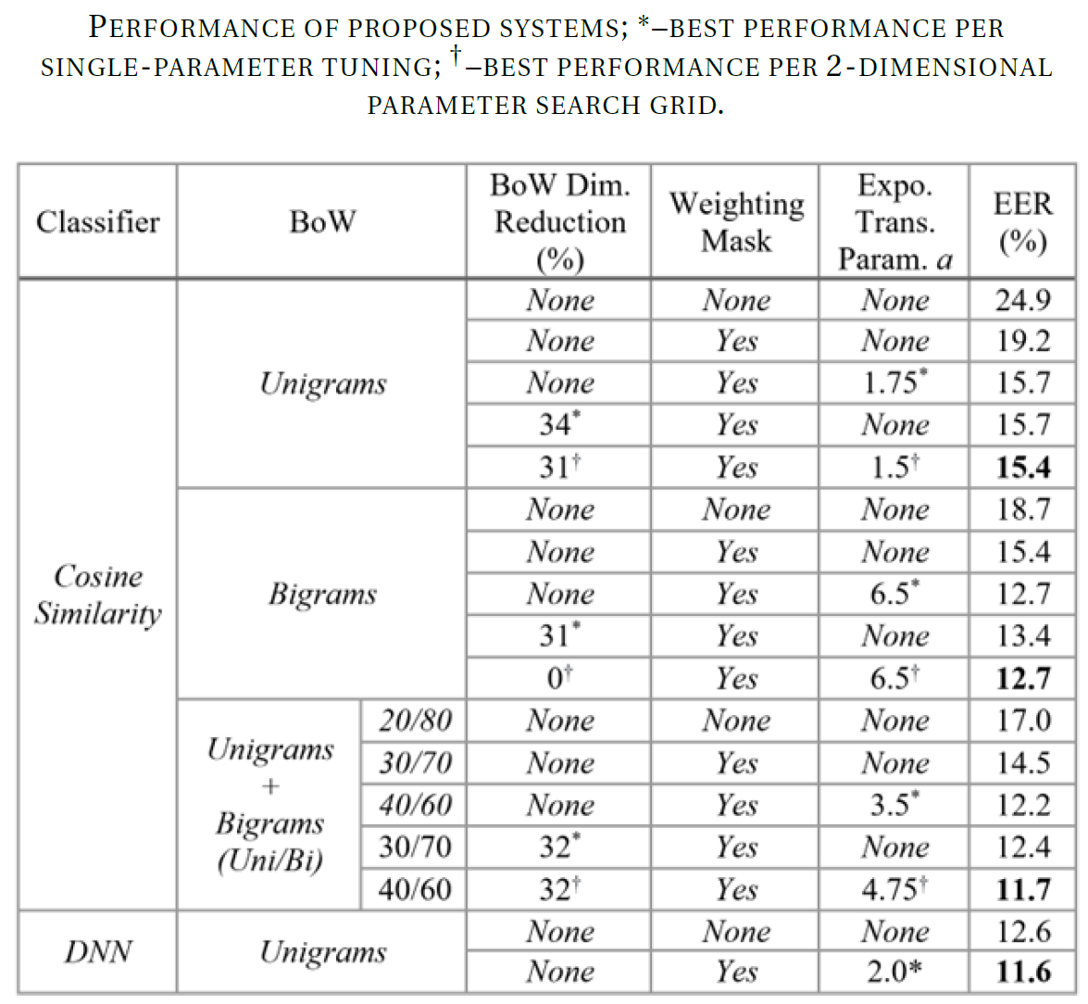
Results

Slide 10
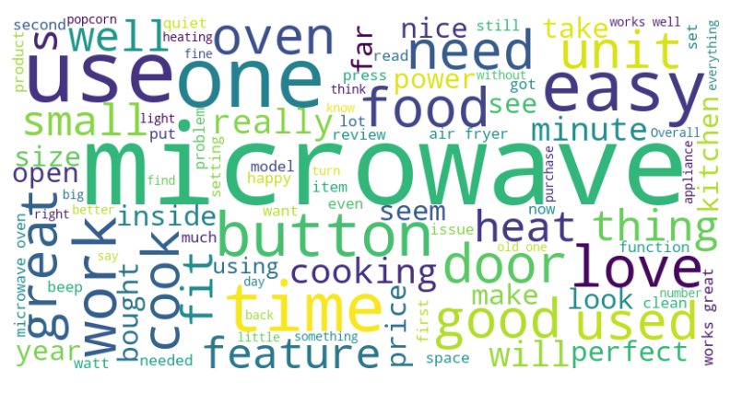
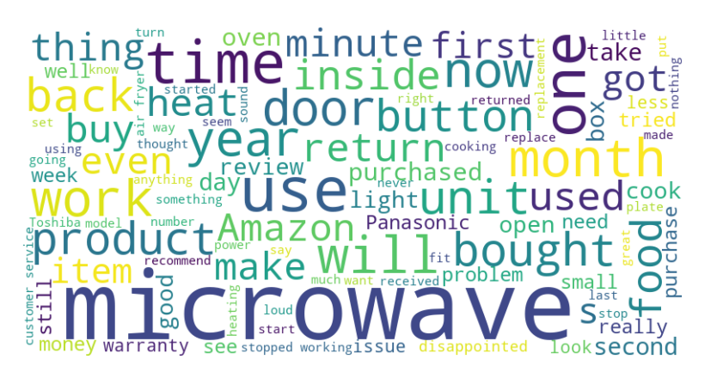
Lexical Analysis with Word Clouds: Class-Specific Unigram Term Frequencies
☹
☺

Slide 11
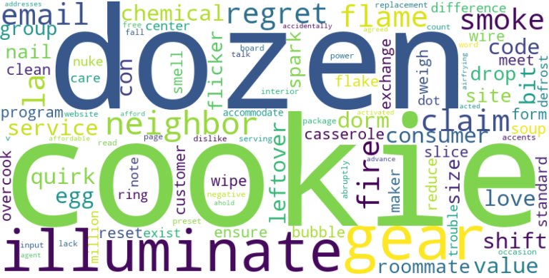
Lexical Analysis with Word Clouds: Unigrams with Highest Relative TF Differences

Slide 12
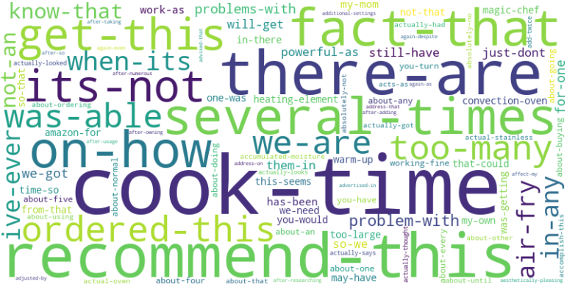
Lexical Analysis with Word Clouds: Bigrams with Highest Relative TF Differences
During preliminary experiments, all highest-ranked bigram pairs had the form <article ‘a’> followed by a word
Solution: set up an ad hoc term filter to remove a-<word> terms and few other ‘dull’ terms

Slide 13
Sentiment Analysis with LSTM and Majority Voting
Isha Paudel, Hynek Boril

Slide 14
Overview
Data same as others
Cleaning the Data / tokenize the data from tensorflow
Make the LSTM Model with Majority voting
Generate confusion matrix based on best threshold

Slide 15
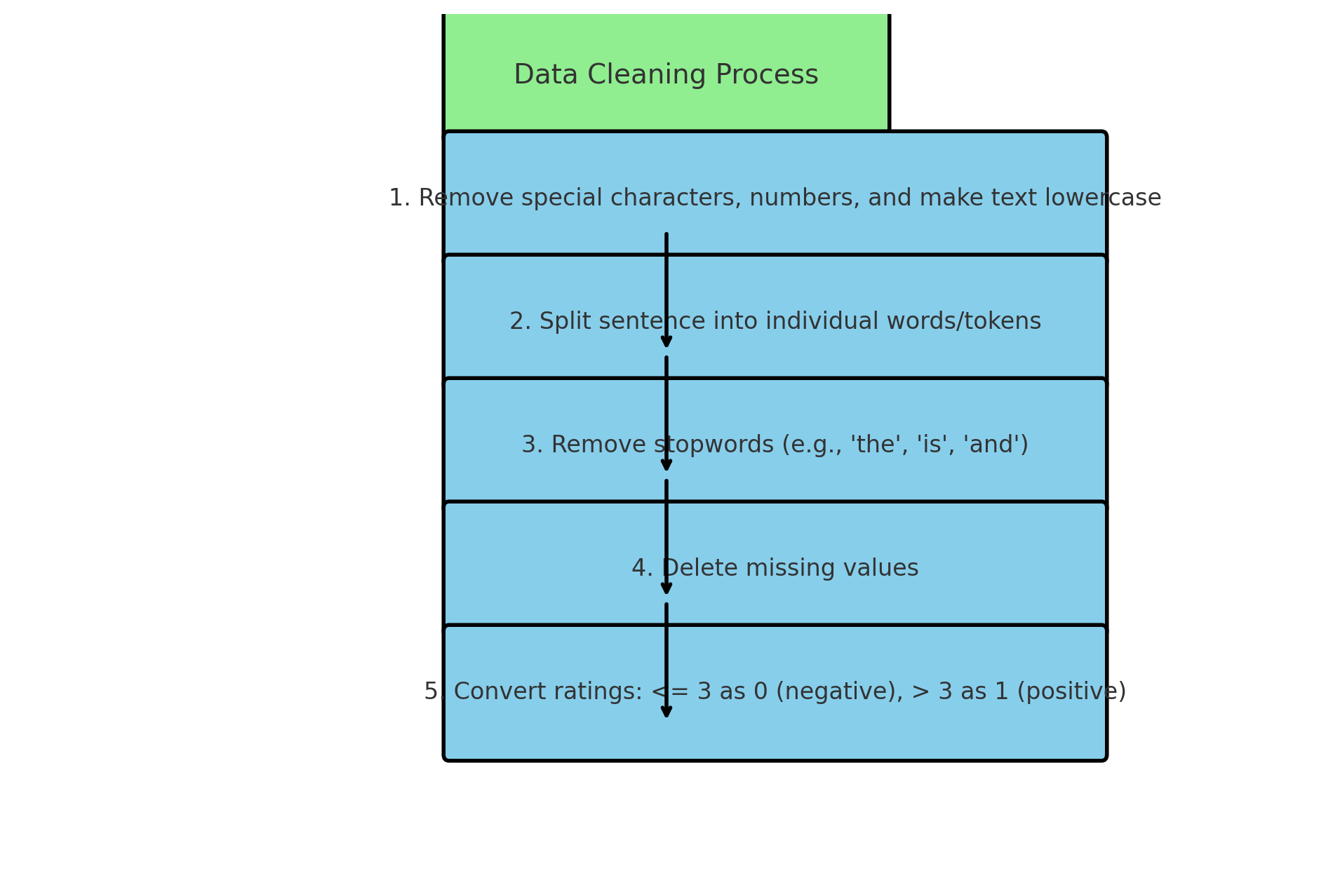

Slide 16
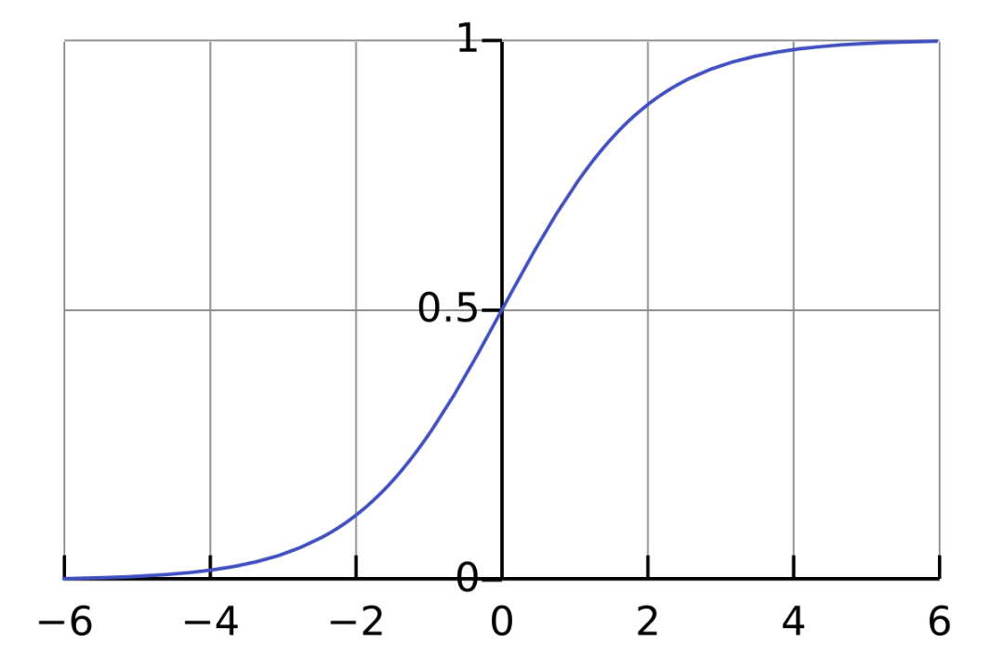
Majority Voting
5 neurons from Dense layer of LSTM
If more than half give 0.5 or more – 1 else 0

Slide 17
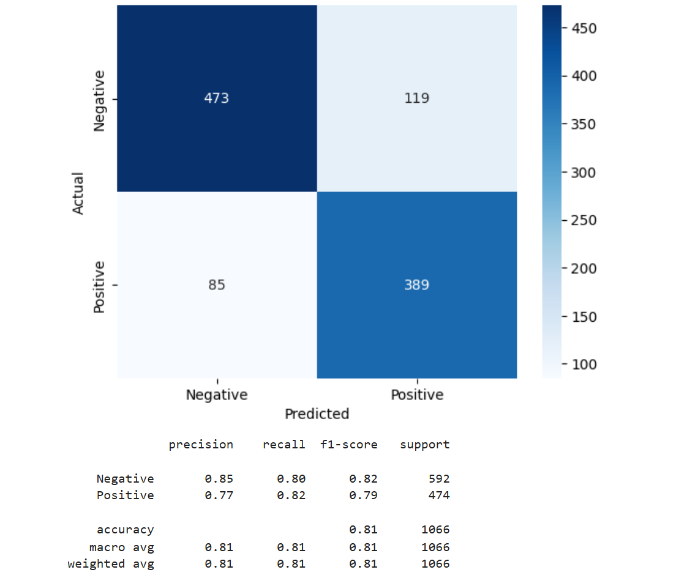
Model Performance

Slide 18
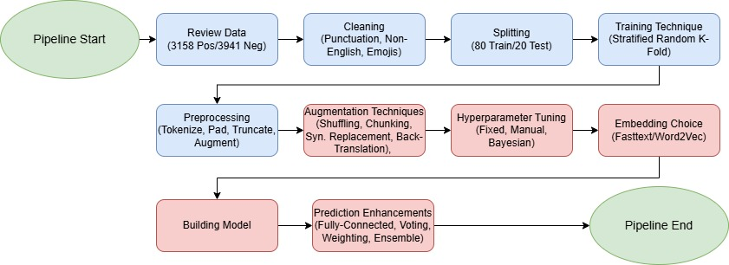
RNN Pipeline
Green: System Endpoints
Blue: Shared Implementation
Red: Individual Implementation

Slide 19
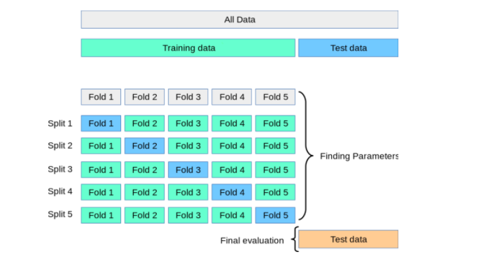
K-Fold Cross-Validation
Split Training into K "Folds" (Hyperparameter)
Each fold is a single iteration of training/validation
Each fold has multiple epochs (hyperparameter). Single pass through entire training set.
Training size determined by: (K-1)/(K*n). K = folds, n = data sample size
Epoch batch size determined by: Training Size/Batch Size (Hyperparameter)

Slide 20
Tokenizing/Truncating/Padding Preprocessing
Assume maximum word count = 5
Each cleaned review tokenized
Maximum review word count fixed or dynamically chosen (hyperparameter)
Truncate or pad with a unique character
Padded characters assigned to a "blank" class (doesn't affect prediction)
"This microwave is not the best"
Becomes
"This microwave is not the"
Assume maximum word count = 7 and padding is "^"
"This microwave is not the best"
Becomes
"This microwave is not the best ^ ^ ^"

Slide 21
FastText Continuous-Bags-of-Words Embeddings and Hidden State Sequence Models for Text Classification
Nicholas Loehrke, Hynek Boril

Slide 22
Shuffling
Original review
"This microwave is not the best"
"microwave This not is best the"
Augmented review
(shuffle size = 2)

Slide 23
Chunking
"This microwave is not the best", 0
"This microwave", 0
"is not", 0
"the best", 0
Original review
Augmented reviews (chunk size = 2)

Slide 24
Review Embeddings
FastText
Extension of Word2vec
Predicts word form context using self-supervised learning
Uses n-gram representations of words
n-grams of 'refrigerator': '<ref', 'refr', 'efri', 'frig', 'rige', 'iger', 'gera', 'erat', 'rato', 'ator', 'tor>'

Slide 25
Example Review Embeddings
"This microwave the best"
[[1, 4, 2], [2, 4, 3], [6, 2, 3], [1, 7, 6]]

Slide 26
Training the RNN
LSTM FC300 ReLU FC2
OR
AR
OR
AR
OR
AR
OR
AR

Slide 27



Extract Hidden States
[[1, 4, 2], [2, 4, 3], [6, 2, 3], [1, 7, 6]]​
​
Fasttext embeddings
LSTM FC300 ReLU FC2
[2, 4]
[[1, 4], [2, 3], [6, 3], [1, 6]]​
​
Hidden state embeddings

Slide 28
Train FFNN for Final Classification
[[1, 4], [2, 3], [6, 3], [1, 6]]​
​
Hidden state embeddings
(Padded with blank vectors)
ReLU
argmax

Slide 29
Results
No augmentation
RNN performed better than RNN + FFNN
With Augmentation
RNN + FFNN improved performance signficantly over RNN only
Assumption
RNN + FFNN contains more parameters, requiring more data to train

Slide 30
Word2Vec Embeddings and Recurrent Model Ensembles for Polarity Classification in Amazon Reviews
Andrew Olsen, Hynek Boril

Slide 31
Word2Vec Embeddings and Recurrent Model Ensembles for Polarity Classification in Amazon Reviews
Andrew Olson, Hynek Boril

Slide 32
Augmentations:
"This microwave is not the best"
Back-Translation:
"Ce micro ondes n'est pas le meilleur" -> "This microwave is not the greatest"
Synonym Replacement:
"This microwave is not the best" -> "This appliance is not the finest"
Chunking with Window = 2:
Chunk 1: "This microwave"
Chunk 2: "microwave is"
Chunk 3: "is not"
Chunk 4: "not the"
Chunk 5: "the best"

Slide 33
Word2Vec embeddings
Two options (both have "window" hyperparameter):
Continuous Bag of Words (CBOW): Target from Context
Multiple Inputs, single output
Skip-gram: Context from Target
Single input, multiple outputs (used pre-trained from Google News for project)
Window = 2
Highlight is prediction
"This microwave is not the best"
CBOW
Skip-gram
"This microwave is"
"This microwave is"
"This microwave is not"
"This microwave is not"
"This microwave is not the"
"This microwave is not the"

Slide 34
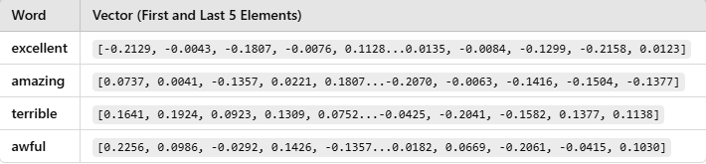
Word2Vec embeddings cont.
Words are converted into vectors to represent "features" (typically 300 dimensions)

Slide 35
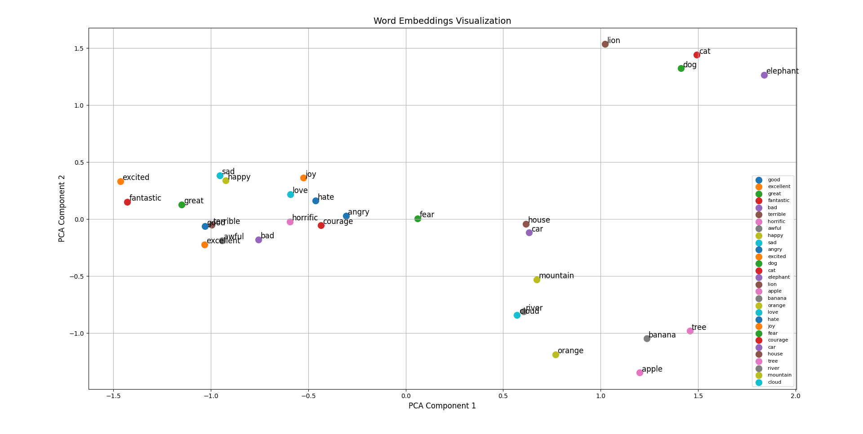
Word2Vec embeddings cont.

Slide 36
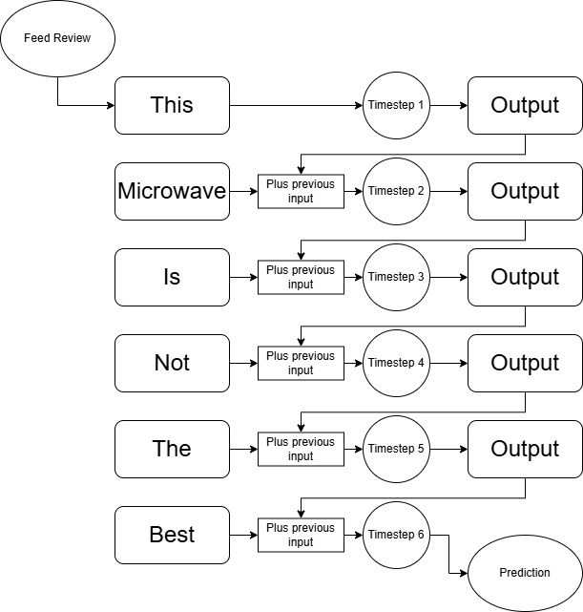
How word2vec is used:
Words fed into RNN sequentially for prediction(Normally):

Slide 37
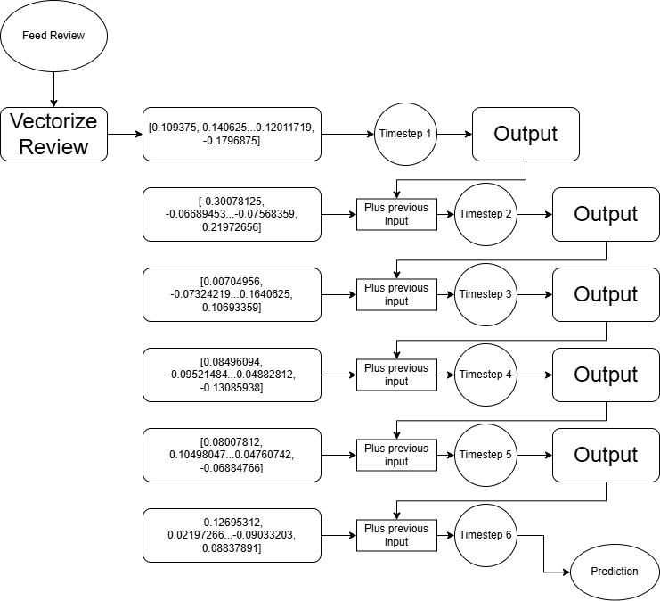
How word2vec is used:
Words converted into vectors, then fed into RNN sequentially for prediction:

Slide 38
Evolution of Model:
Simple RNN
LSTM
Bidirectional LSTM
Cascading Bidirectional LSTM
Cascading Ensemble of Bidirectional LSTMs

Slide 39
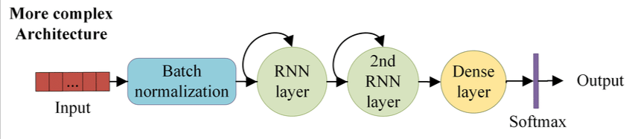
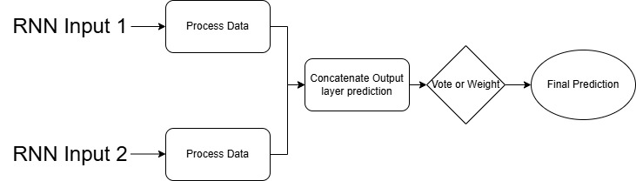
Model Structures:
Cascade:
Ensemble:

Slide 40
Impacts on performance averages:
Base words -> Word2Vec embeddings: 68-69% average -> 70-72% average
Cascade -> Cascade + Ensemble: 73% average -> 74-76% average
Bayesian Optimization: Trade-off with training time for a small increase (1-2%)
Method to optimize hyperparameters by balancing "exploration" (reduction of areas of uncertainty) and "exploitation" (maximization of areas of certainty)

Slide 41
Notes and Future Implementations:
Bayesian Optimization: Drastically increased training time with small increase to accuracy (1-2%)
Restricted to around 77-80% accuracy (dataset size limitations?)
Generate plots and data for analysis with Augmentations

Slide 42
Thank You

